Slide 1

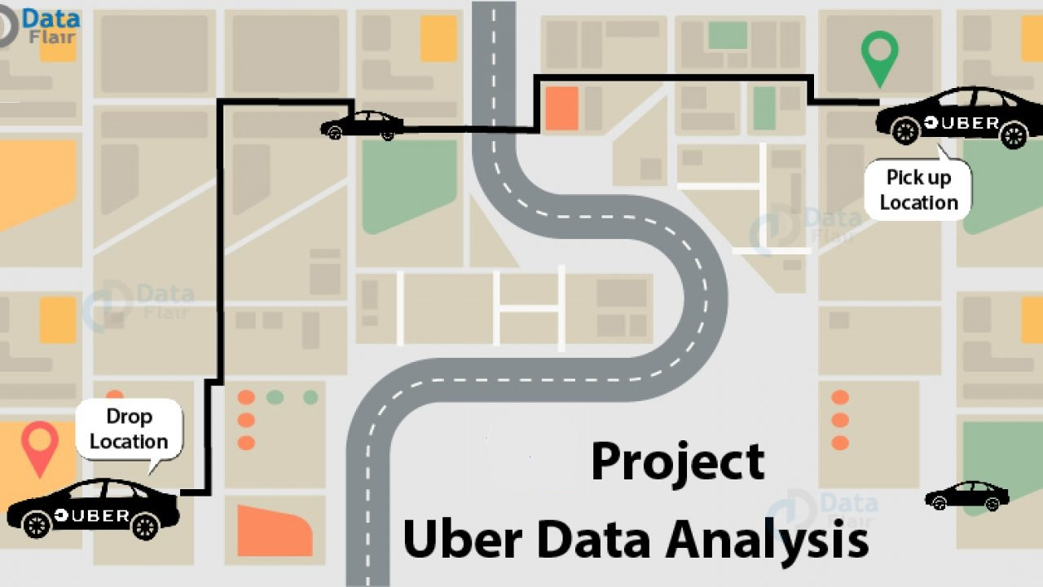

Uber Data Analysis

Slide 2
PRESENTED BY : Mr. Pratik Kale Mr. Tasarif Pathan

Slide 3

Aim
Complete Data Analysis and Exploration of Uber Dataset

Slide 4

The objective is to first explore hidden or previously unknown information by applying exploratory data analytics on the dataset and to know the effect of each field on price with every other field of the dataset. Then we apply different machine learning models to complete the analysis. After this, the results of applied machine learning models were compared and analyzed on the basis of accuracy, and then the best performing model was suggested for further predictions of the label ‘Price’.
Objective

Slide 5
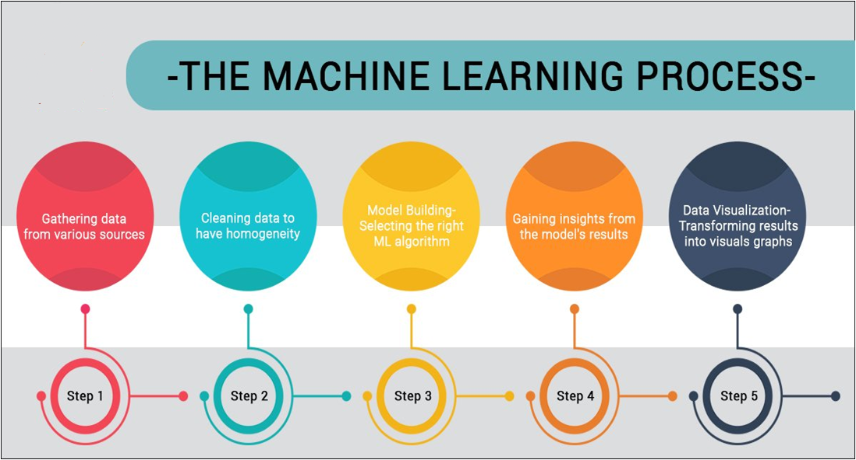

Slide 6



Data Set:
Kaggle
CSV Format
Shape: 693071,57

Slide 7

Libraries

Slide 8

Exploratory Data Analysis
Exploratory Data Analysis refers to the critical
process of performing initial investigations on data so
as to discover patterns to spot anomalies to test hypothesis
and to check assumptions with the help of summary statistics
and graphical representations.
It is a good practice to understand the data first and try to
gather as many insights from it.
EDA is all about making sense of data in hand.

Slide 9
Feature Engineering
All machine learning algorithms use some input data to create outputs. This input data comprise features, which are usually in the form of structured columns. Algorithms require features with some specific characteristics to work properly and so the need for feature engineering arises.
I think feature engineering efforts mainly have two goals:
Preparing the proper input dataset, compatible with the machine learning algorithm requirements.
Improving the performance of machine learning models.

Slide 10
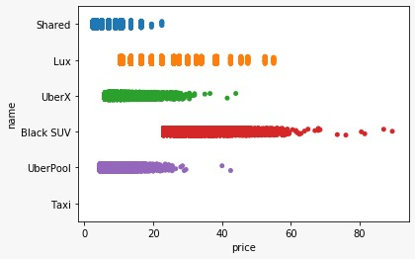
Strip-plot between Name and Price

Slide 11


Label Encoding
Label Encoding refers to converting the labels into numeric form so as to convert it into the machine-readable form. Machine learning algorithms can then decide in a better way on how those labels must be operated. It is an important pre-processing step for the structured dataset in supervised learning.

Slide 12

NANs(missing values)
Our data set contain NANs only in Price column.
The count of nans is: 55095
The nans is filled with the median of other values.

Slide 13
Feature Selection
Feature Selection is the process of selecting a subset of relevant feature (variables, predictors) for use in model construction.
Recursive Feature Elimination
:
Recursive feature elimination (RFE) is a feature selection method that fits a model and removes the weakest feature (or features) until the specified number of features is reached.
 | A | B | C
Yellow | 10 | 20 | 7
Blue | 30 | 15 | 10
Orange | 5 | 24 | 16

Slide 14
After applying RFE on given data set with Linear Regression, we found accuracy with different no of columns as follows:-
Serial No. | No. of Feature | Score
1 | 40 | 0.42690513
2 | 25 | 0.42734024
3 | 15 | 0.42686612

Slide 15
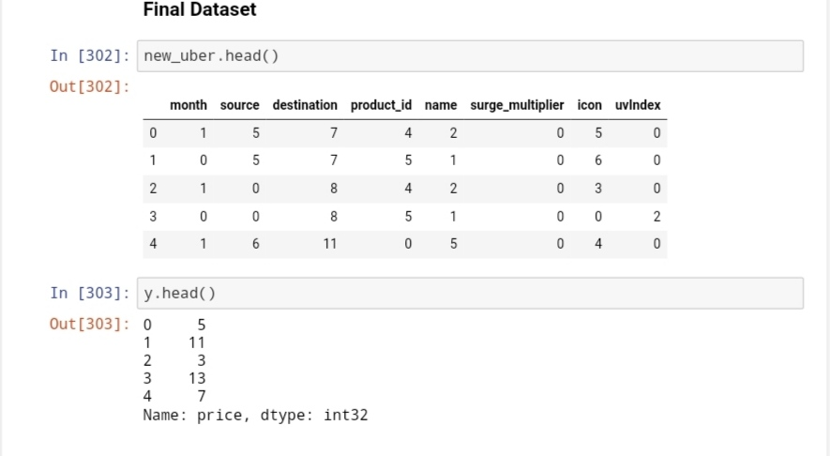
Final Dataset

Slide 16

Modeling
After Completion of Recursive Feature Elimination process, we can done Modeling on final dataset.

Slide 17
Linear Regression:
Linear Regression is a supervised machine learning algorithm where the predicted output is continuous and has a constant slope. It’s used to predict values within a continuous range.
Decision Tree:
A decision tree is a graphical representation of all the possible solutions to a decision based on certain conditions.
Gradient Boosting Regressor :
Gradient boosting is a machine learning technique for regression and classification problems, which produces a prediction model in the form of an ensemble of weak prediction models, typically decision trees. It builds the model in a stage-wise fashion like other boosting methods do, and it generalizes them by allowing optimization of an arbitrary differentiable loss function.

Slide 18
After applying different models on final dataset, we found different accuracy as given below :-
Serial No. | Models | Score
1 | Linear Regression | 0.42770153
2 | Decision Tree | 0.92214711
3 | Gradient Boosting Regressor | 0.95800537

Slide 19
Testing
The usage of the word "testing" in relation to machine learning models is primarily used for testing the model performance in terms of accuracy/precision of the model.

Slide 20
With the help of linear regression models, we predict the price, plot a graph between actual and predicted values and find the following errors:-
For linear regression:-
MAE : 4.12943349
MSE : 26.54324419
RMSE : 5.15201360

Slide 21
Price Prediction Function
At last, we create a function for price prediction which take cab name, source, surge multiplier and icon as input and predict the price.

Slide 22


Free templates for all your presentation needs
For PowerPoint and Google Slides
100% free for personal or commercial use
Ready to use, professional and customizable
Blow your audience away with attractive visuals

